Slide 1
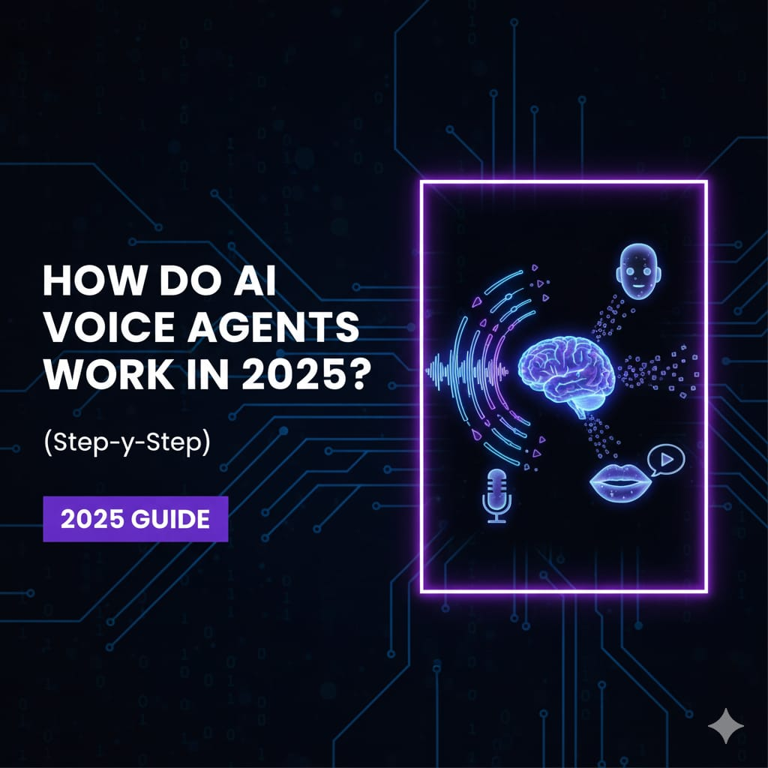
Basic Details of Team and Problem Statement
Problem Statement Title: Lack of centralized information
on blood availability across
different cities.
Team Leader Name: Vasdev
Team ID: T016
Team Name: Tech Titans
Theme Name: Open Innovation
PS Category: Software

Slide 2
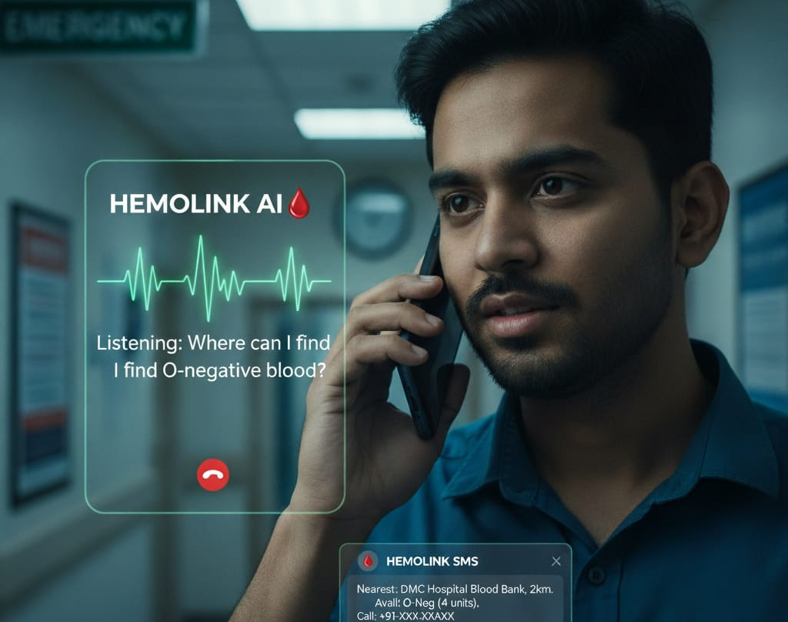
Idea/Approach Details
Create a smart AI assistant that you can call on the phone. When you're in an emergency in anywhere, you can ask it things like, "Where can I find O-negative blood?" and it will instantly tell you the nearest location and send you a text with the details.

Slide 3




TECHNICAL APPROACH

Slide 4
FEASIBILITY AND VIABILITY
1. 24/7 Availability
Families and hospitals can call anytime to ask for blood availability.
Retell AI answers instantly, unlike manual operators with limited working hours.
2. Centralized Information Access
The AI can connect with a centralized database of blood availability across multiple hospitals and cities.
This avoids the problem of calling different blood banks one by one.
3. Faster Emergency Response
In urgent cases, Retell AI quickly provides information on which hospital has the required blood group.
Can even guide the caller to the nearest available location.

Slide 5
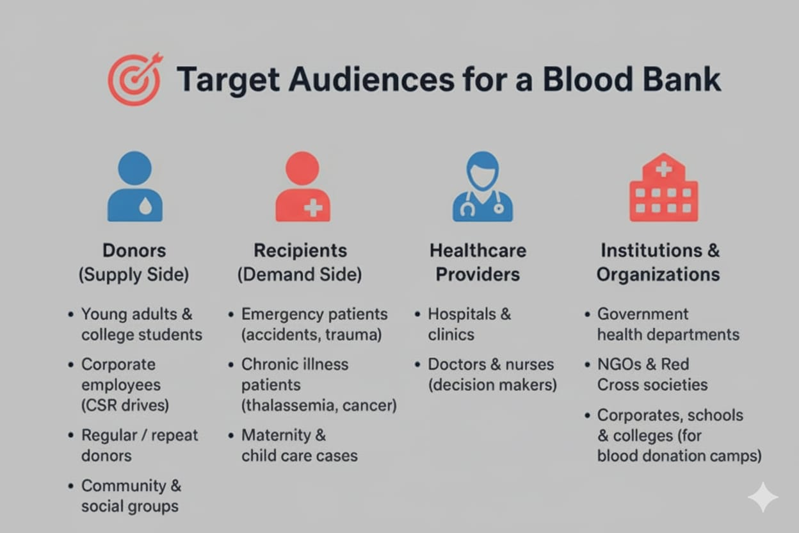
IMPACT AND BENEFITS

Slide 6
RESEARCH AND REFERENCES
https://www.justdial.com/
https://www.cgierbil.gov.in/hospitals-in-india.php
https://indianhelpline.com/blood-banks
https://portal.nabh.co/frmViewAccreditedBloodBank.aspx
https://www.naco.gov.in/national-blood-transfusion-council-nbtc
https://www.naco.gov.in/national-blood-transfusion-council-nbtc
https://www.google.com/maps/d
https://gemini.google.com
https://assistant.google.com
https://bloodlinks.in/details_bank
https://bloodlinks.in/details_bank

